Slide 1


Slide 2
Layout in HTML5

Slide 3
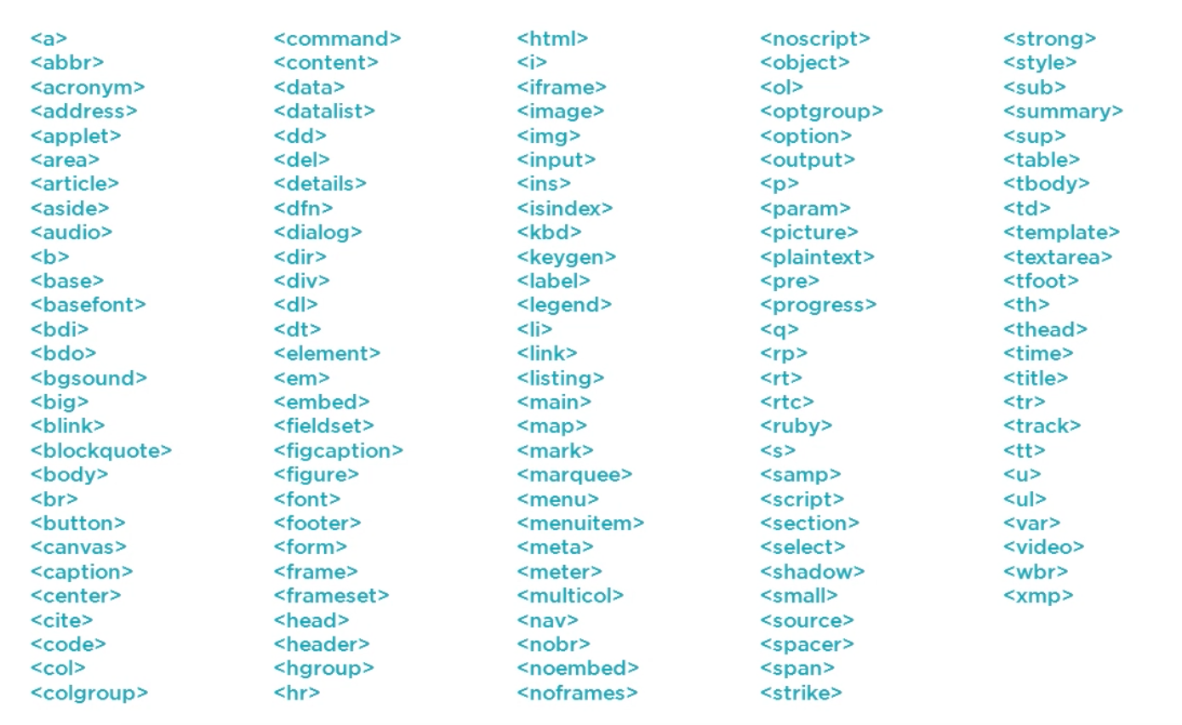
HTML elements
Which one to use?

Slide 4
Semantic HTML elements
Don’t use generic HTML elements (div)
Try to use appropriate tag based on element content
By using the right elements, we provide context for element content
Semantic description is important for:
developers
machines (screen readers, crawlers…)

Slide 5
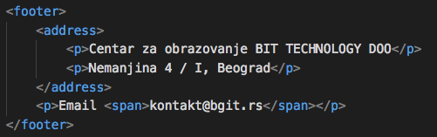
Semantic Description Example

Slide 6
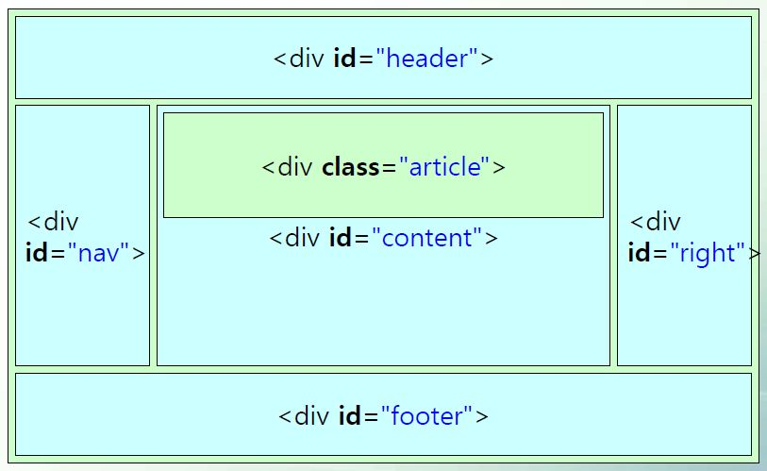
HTML4/XHTML Layout

Slide 7
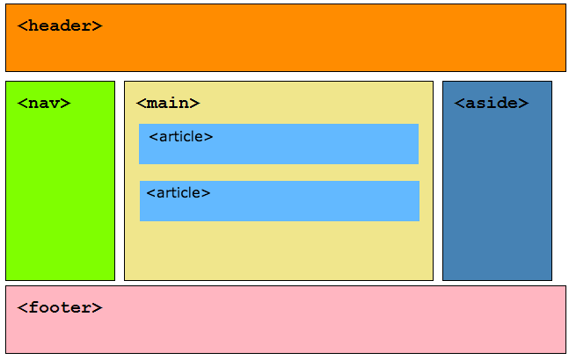
HTML5 Semantic Layout

Slide 8


Header & Navigation
<header>
<nav>

Slide 9
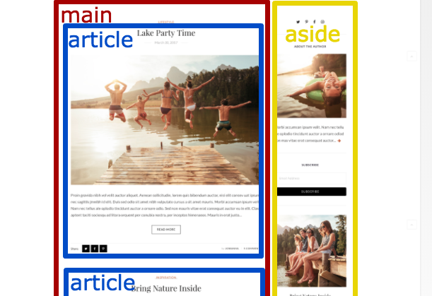
Main, Article and Aside
<main> - main content (once per page)
<aside> - content that is not essential
<article> - independent, self-contained content

Slide 10
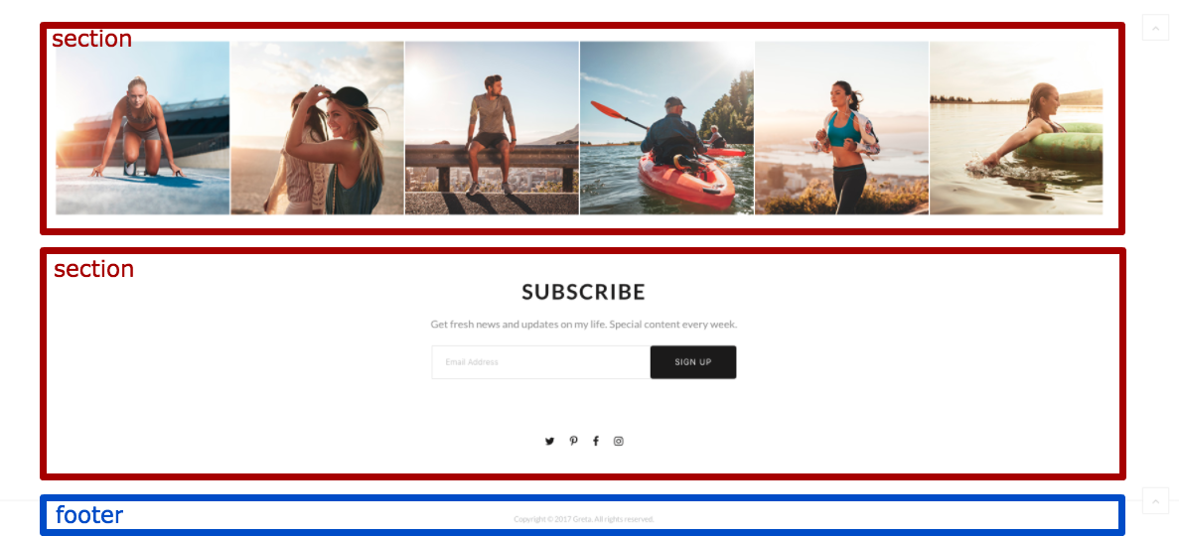
Section and Footer
<section> - logical section in a document
<footer> - footer of a document or a section

Slide 11
Exercise

Slide 12
References
Semantic Elements: https://goo.gl/EGttxN
Basic Semantic Page Structure: https://goo.gl/RERJvf
Semantic HTML Tutorial: https://goo.gl/bjJSjN

